Slide 1
Decision Models
Chapter 6

Slide 2
6.1 Introduction to Decision Analysis
The field of decision analysis provides a framework for making important decisions.
Decision analysis allows us to select a decision from a set of possible decision alternatives when uncertainties regarding the future exist.
The goal is to optimize the resulting payoff in terms of a decision criterion.

Slide 3
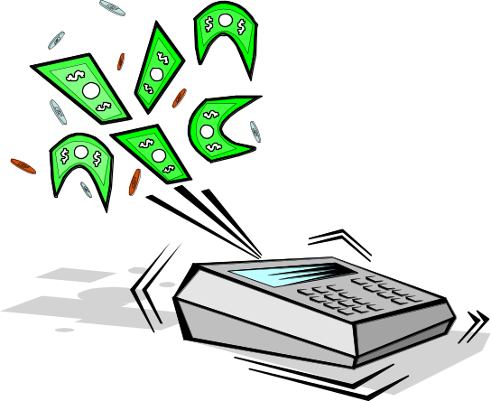
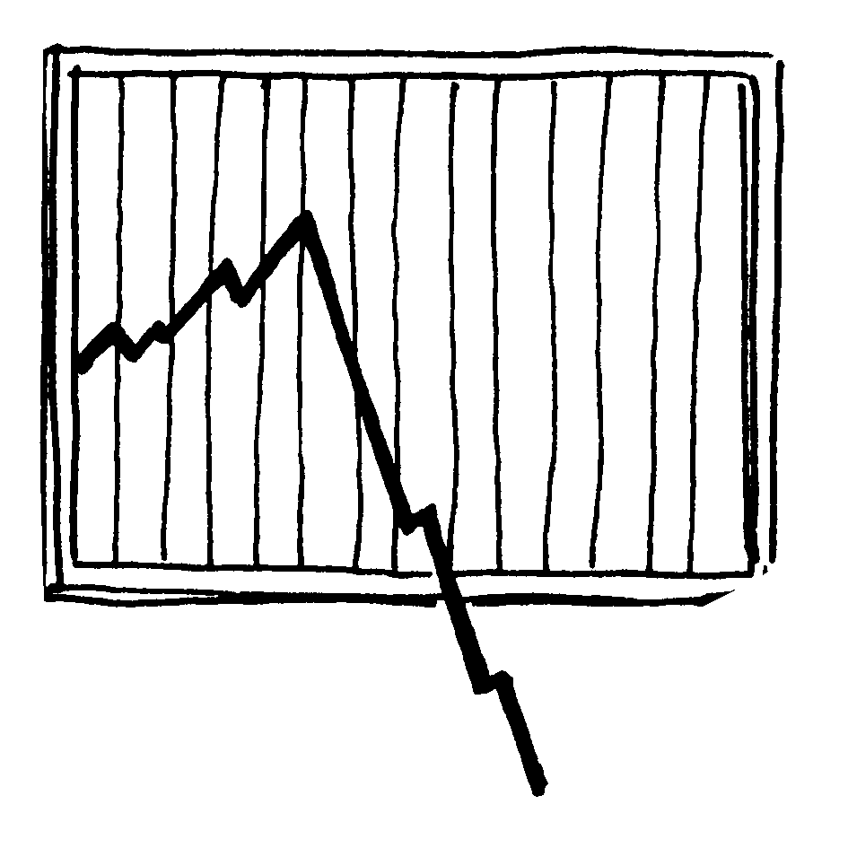
6.1 Introduction to Decision Analysis
Maximizing expected profit is a common criterion when probabilities can be assessed.
Maximizing the decision maker’s utility function is the mechanism used when risk is factored into the decision making process.

Slide 4
6.2 Payoff Table Analysis
Payoff Tables
  Payoff table analysis can be applied when:
    There is a finite set of discrete decision alternatives.
    The outcome of a decision is a function of a single future event.
  In a Payoff table -
    The rows correspond to the possible decision alternatives.
    The columns correspond to the possible future events.
    Events (states of nature) are mutually exclusive and collectively exhaustive.
    The table entries are the payoffs.

Slide 5
TOM BROWN INVESTMENT DECISION
Tom Brown has inherited $1000.
He has to decide how to invest the money for one year.
A broker has suggested five potential investments.
  Gold
  Junk Bond
  Growth Stock
  Certificate of Deposit
  Stock Option Hedge

Slide 6
TOM BROWN
The return on each investment depends on the (uncertain) market behavior during the year.
Tom would build a payoff table to help make the investment decision

Slide 7
TOM BROWN - Solution
Construct a payoff table.
Select a decision making criterion, and apply it to the payoff table.
Identify the optimal decision.
Evaluate the solution.
 | S1 | S2 | S3 | S4
D1 | p₁₁ | p₁₂ | p₁₃ | p₁₄
D2 | p₂₁ | p₂₂ | p₂₃ | P₂₄
D3 | p₃₁ | p₃₂ | p₃₃ | p₃₄
 | S1 | S2 | S3 | S4
D1 | p₁₁ | p₁₂ | p₁₃ | p₁₄
D2 | p₂₁ | p₂₂ | p₂₃ | P₂₄
D3 | p₃₁ | p₃₂ | p₃₃ | p₃₄
Criterion
P1
P2
P3

Slide 8
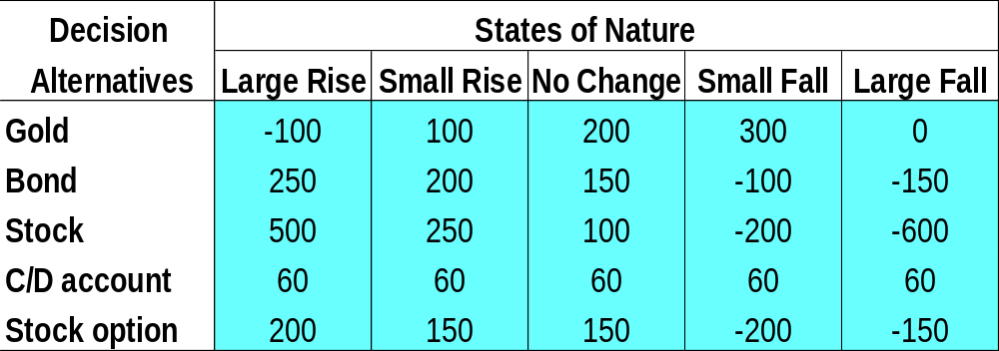
The Payoff Table
DJA is up more
than1000 points
DJA is up
[+300,+1000]
DJA moves
within
[-300,+300]
DJA is down
[-300, -800]
DJA is down more
than 800 points
  Define the states of nature.
The states of nature are mutually exclusive and collectively exhaustive.

Slide 9
The Payoff Table
  Determine the set of possible decision alternatives.

Slide 10
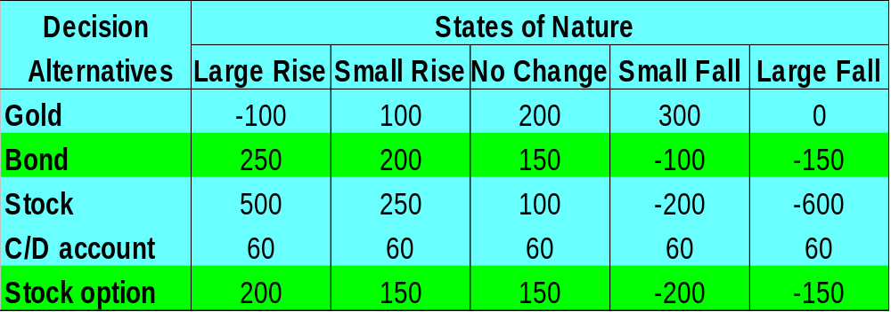
The Payoff Table
250
200
150
-100
-150
-150
The stock option alternative is dominated by the
bond alternative

Slide 11
6.3 Decision Making Criteria
Classifying decision-making criteria
  Decision making under certainty.
    The future state-of-nature is assumed known.
  Decision making under risk.
    There is some knowledge of the probability of the states of nature occurring.
  Decision making under uncertainty.
    There is no knowledge about the probability of the states of nature occurring.

Slide 12
Decision Making Under Uncertainty
The decision criteria are based on the decision maker’s
attitude toward life.
The criteria include the
  Maximin Criterion - pessimistic or conservative approach.
  Minimax Regret Criterion - pessimistic or conservative approach.
  Maximax Criterion - optimistic or aggressive approach.
  Principle of Insufficient Reasoning – no information about the likelihood of the various states of nature.

Slide 13


Decision Making Under Uncertainty - The Maximin Criterion

Slide 14
Decision Making Under Uncertainty - The Maximin Criterion
This criterion is based on the worst-case scenario.
  It fits both a pessimistic and a conservative decision
  maker’s styles.
  A pessimistic decision maker believes that the worst possible result will always occur.
  A conservative decision maker wishes to ensure a guaranteed minimum possible payoff.

Slide 15
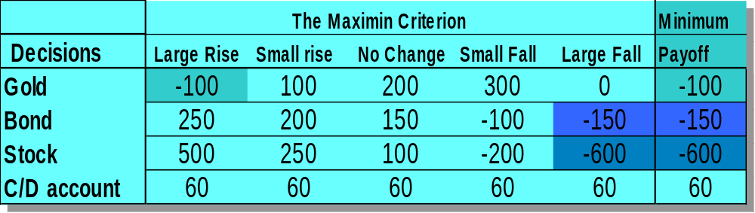
TOM BROWN - The Maximin Criterion
To find an optimal decision
  Record the minimum payoff across all states of nature for each decision.
  Identify the decision with the maximum “minimum payoff.”
The optimal decision

Slide 16
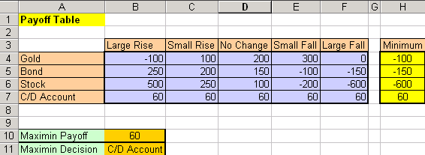
The Maximin Criterion - spreadsheet
=MAX(H4:H7)
=MIN(B4:F4)
Drag to H7
* FALSE is the range lookup argument in the VLOOKUP function in cell B11 since the values in column H are not in ascending order
=VLOOKUP(MAX(H4:H7),H4:I7,2,FALSE)

Slide 17
The Maximin Criterion - spreadsheet
I4
Cell I4 (hidden)=A4
Drag to I7
To enable the spreadsheet to correctly identify the optimal maximin decision in cell B11, the labels for cells A4 through A7 are copied into cells I4 through I7 (note that column I in the spreadsheet is hidden).

Slide 18

Decision Making Under Uncertainty - The Minimax Regret Criterion

Slide 19
Decision Making Under Uncertainty - The Minimax Regret Criterion
  The Minimax Regret Criterion
      This criterion fits both a pessimistic and a conservative decision maker approach.
      The payoff table is based on “lost opportunity,” or “regret.”
      The decision maker incurs regret by failing to choose the “best” decision.

Slide 20
Decision Making Under Uncertainty - The Minimax Regret Criterion
The Minimax Regret Criterion
  To find an optimal decision, for each state of nature:
    Determine the best payoff over all decisions.
    Calculate the regret for each decision alternative as the difference between its payoff value and this best payoff value.
  For each decision find the maximum regret over all states of nature.
  Select the decision alternative that has the minimum of these “maximum regrets.”

Slide 21
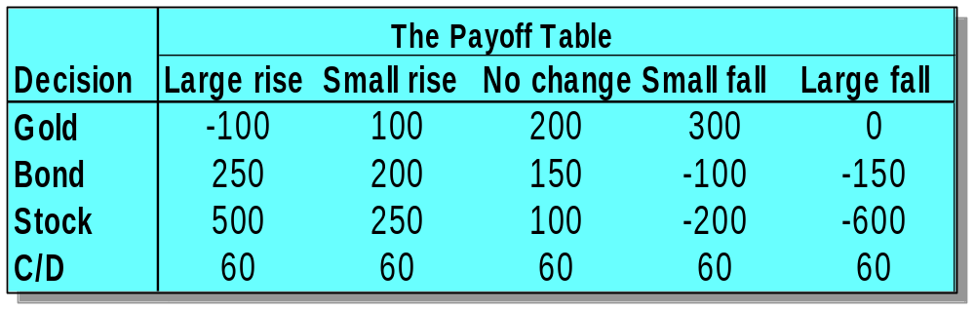
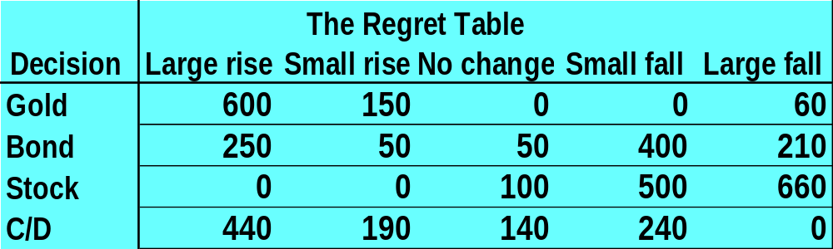
TOM BROWN – Regret Table
Investing in Stock generates no regret when the market exhibits
a large rise
Let us build the Regret Table

Slide 22
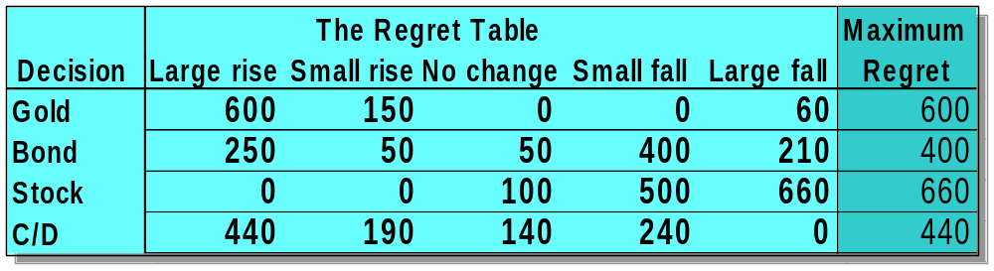
TOM BROWN – Regret Table
Investing in gold generates a regret of 600 when the market exhibits
a large rise
500 – (-100) = 600
The optimal decision

Slide 23
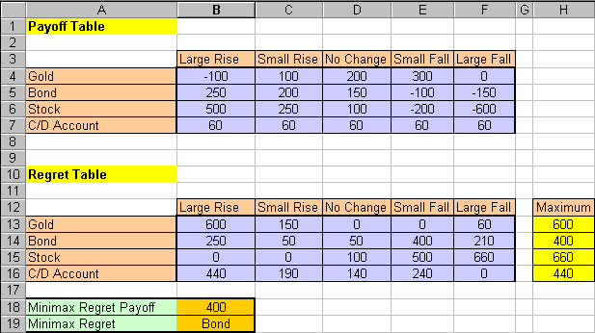
The Minimax Regret - spreadsheet
=MAX(B14:F14)
Drag to H18
=MAX(B$4:B$7)-B4
Drag to F16
Cell I13 (hidden) =A13
Drag to I16
=MIN(H13:H16)
=VLOOKUP(MIN(H13:H16),H13:I16,2,FALSE)

Slide 24
Decision Making Under Uncertainty - The Maximax Criterion
This criterion is based on the best possible scenario.
It fits both an optimistic and an aggressive decision maker.
An optimistic decision maker believes that the best possible outcome will always take place regardless of the decision made.
An aggressive decision maker looks for the decision with the highest payoff (when payoff is profit).

Slide 25
Decision Making Under Uncertainty - The Maximax Criterion
To find an optimal decision.
  Find the maximum payoff for each decision alternative.
  Select the decision alternative that has the maximum of the “maximum” payoff.

Slide 26
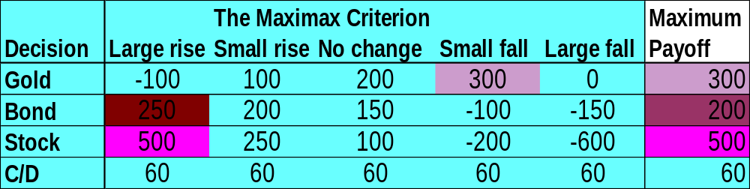
TOM BROWN - The Maximax Criterion
The optimal decision

Slide 27
Decision Making Under Uncertainty - The Principle of Insufficient Reason
This criterion might appeal to a decision maker who is neither pessimistic nor optimistic.
  It assumes all the states of nature are equally likely to occur.
  The procedure to find an optimal decision.
    For each decision add all the payoffs.
    Select the decision with the largest sum (for profits).

Slide 28
TOM BROWN - Insufficient Reason
Sum of Payoffs
  Gold 600 Dollars
  Bond 350 Dollars
  Stock 50 Dollars
  C/D 300 Dollars
Based on this criterion the optimal decision alternative is to invest in gold.

Slide 29
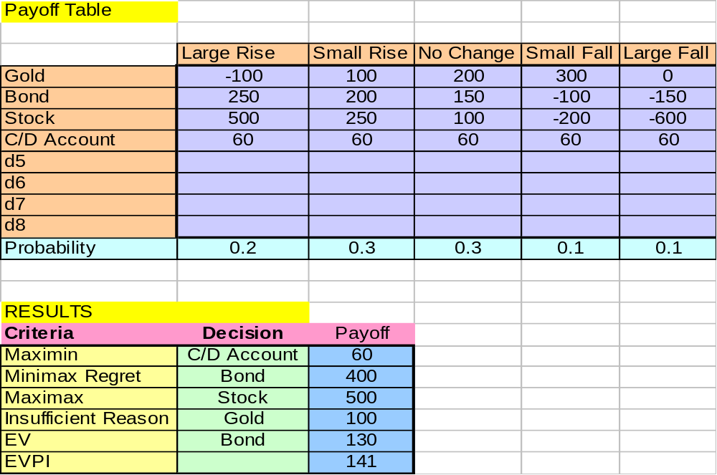
Decision Making Under Uncertainty – Spreadsheet template

Slide 30
Decision Making Under Risk
The probability estimate for the occurrence of
each state of nature (if available) can be incorporated in the search for the optimal decision.
For each decision calculate its expected payoff.

Slide 31
Decision Making Under Risk –
The Expected Value Criterion
For each decision calculate the expected payoff as follows:
(The summation is calculated across all the states of nature)
Select the decision with the best expected payoff
Expected Payoff = Σ(Probability)(Payoff)

Slide 32
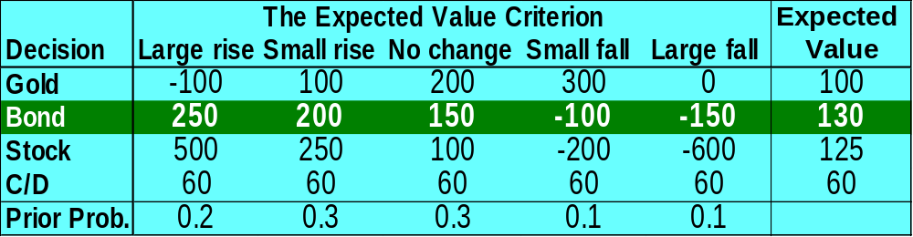
TOM BROWN - The Expected Value Criterion
The optimal decision
EV = (0.2)(250) + (0.3)(200) + (0.3)(150) + (0.1)(-100) + (0.1)(-150) = 130

Slide 33
When to use the expected value approach
The expected value criterion is useful generally in two cases:
  Long run planning is appropriate, and decision situations repeat themselves.
  The decision maker is risk neutral.

Slide 34
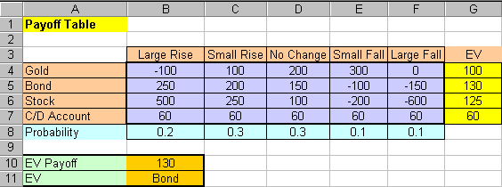
The Expected Value Criterion - spreadsheet
Cell H4 (hidden) = A4
Drag to H7
=SUMPRODUCT(B4:F4,$B$8:$F$8)
Drag to G7
=MAX(G4:G7)
=VLOOKUP(MAX(G4:G7),G4:H7,2,FALSE)

Slide 35
6.4 Expected Value of Perfect Information
The gain in expected return obtained from knowing with certainty the future state of nature is called:
Expected Value of Perfect Information (EVPI)

Slide 36
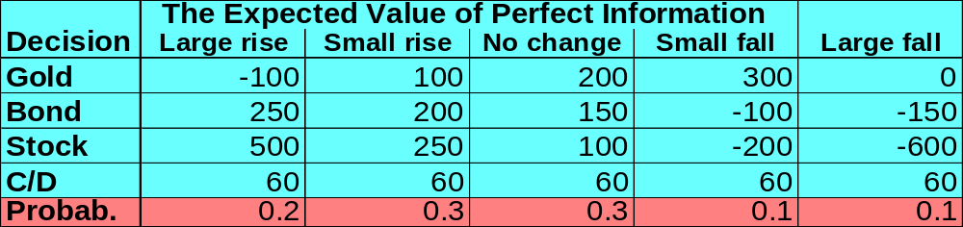
TOM BROWN - EVPI
If it were known with certainty that there will be a “Large Rise” in the market
-100
250
500
60
Large rise
Stock
... the optimal decision would be to invest in...
Similarly,…

Slide 37
TOM BROWN - EVPI
-100
250
500
60
Expected Return with Perfect information =
ERPI = 0.2(500)+0.3(250)+0.3(200)+0.1(300)+0.1(60) = $271
Expected Return without additional information =
Expected Return of the EV criterion = $130
EVPI = ERPI - EREV = $271 - $130 = $141

Slide 38
6.5 Bayesian Analysis - Decision Making with Imperfect Information
Bayesian Statistics play a role in assessing additional information obtained from various sources.
This additional information may assist in refining original probability estimates, and help improve decision making.

Slide 39
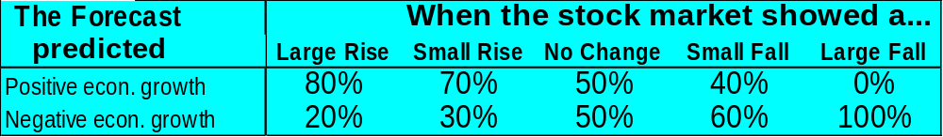
TOM BROWN – Using Sample Information
Tom can purchase econometric forecast results for $50.
The forecast predicts “negative” or “positive” econometric growth.
Statistics regarding the forecast are:
Should Tom purchase the Forecast ?
When the stock market showed a large rise the
Forecast predicted a “positive growth” 80% of the time.

Slide 40
TOM BROWN – Solution
Using Sample Information
If the expected gain resulting from the decisions made with the forecast exceeds $50, Tom should purchase the forecast.
The expected gain =
Expected payoff with forecast – EREV
To find Expected payoff with forecast Tom should determine what to do when:
  The forecast is “positive growth”,
  The forecast is “negative growth”.

Slide 41
TOM BROWN – Solution
Using Sample Information
Tom needs to know the following probabilities
  P(Large rise | The forecast predicted “Positive”)
  P(Small rise | The forecast predicted “Positive”)
  P(No change | The forecast predicted “Positive ”)
  P(Small fall | The forecast predicted “Positive”)
  P(Large Fall | The forecast predicted “Positive”)
  P(Large rise | The forecast predicted “Negative ”)
  P(Small rise | The forecast predicted “Negative”)
  P(No change | The forecast predicted “Negative”)
  P(Small fall | The forecast predicted “Negative”)
  P(Large Fall) | The forecast predicted “Negative”)

Slide 42
TOM BROWN – Solution
Bayes’ Theorem
Bayes’ Theorem provides a procedure to calculate these probabilities
P(B|A_{i})P(A_{i})
P(B|A₁)P(A₁)+ P(B|A₂)P(A₂)+…+ P(B|A_{n})P(A_{n})
P(A_{i}|B) =
Posterior Probabilities
Probabilities determined
after the additional info
becomes available.
Prior probabilities
Probability estimates
determined based on
current info, before the
new info becomes available.

Slide 43
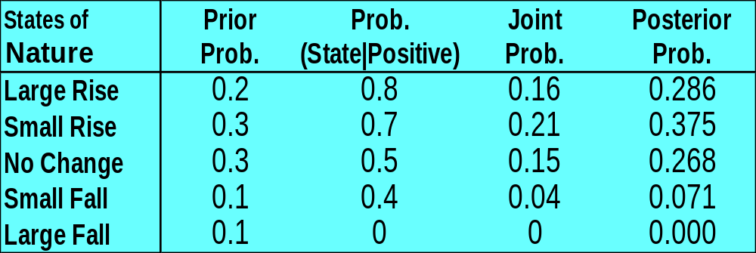
TOM BROWN – Solution
Bayes’ Theorem
The tabular approach to calculating posterior
probabilities for “positive” economical forecast
X
=
The Probability that the forecast is “positive” and the stock market shows “Large Rise”.

Slide 44
TOM BROWN – Solution
Bayes’ Theorem
The tabular approach to calculating posterior
probabilities for “positive” economical forecast
0.16
0.56
X
=
The probability that the stock market
shows “Large Rise” given that
the forecast is “positive”

Slide 45
TOM BROWN – Solution
Bayes’ Theorem
The tabular approach to calculating posterior
probabilities for “positive” economical forecast
X
=
Observe the revision in
the prior probabilities
Probability(Forecast = positive) = .56

Slide 46
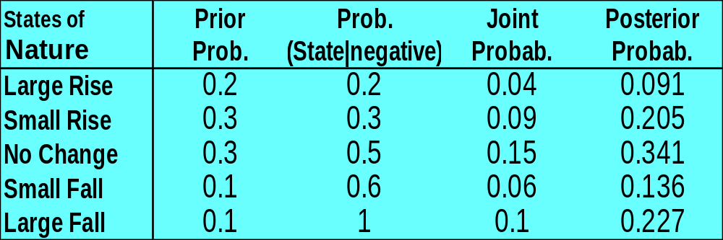
TOM BROWN – Solution
Bayes’ Theorem
The tabular approach to calculating posterior
probabilities for “negative” economical forecast
Probability(Forecast = negative) = .44

Slide 47
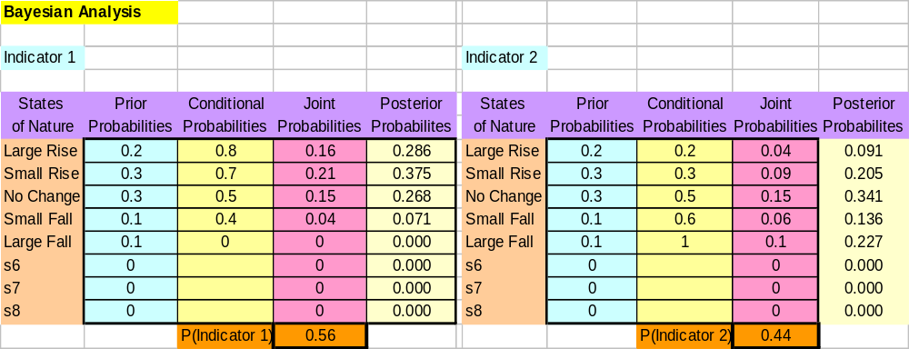
Posterior (revised) Probabilities spreadsheet template

Slide 48
Expected Value of Sample Information
EVSI
This is the expected gain from making decisions based on Sample Information.
Revise the expected return for each decision using the posterior probabilities as follows:

Slide 49
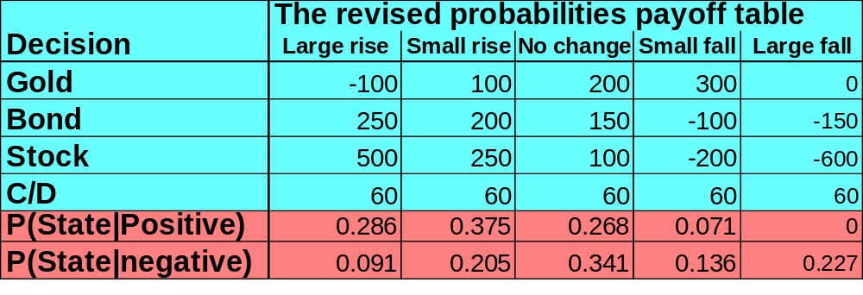
TOM BROWN – Conditional Expected Values
  EV(Invest in……. |“Positive” forecast) =
  =.286( )+.375( )+.268( )+.071( )+0( ) =
  EV(Invest in ……. | “Negative” forecast) =
  =.091( )+.205( )+.341( )+.136( )+.227( ) =
GOLD
-100
100
200
300
0
$84
GOLD
-100
100
200
300
0
$120

Slide 50
TOM BROWN – Conditional Expected Values
The revised expected values for each decision:
  Positive forecast Negative forecast
  EV(Gold|Positive) = 84 EV(Gold|Negative) = 120
  EV(Bond|Positive) = 180 EV(Bond|Negative) = 65
  EV(Stock|Positive) = 250 EV(Stock|Negative) = -37
  EV(C/D|Positive) = 60 EV(C/D|Negative) = 60
If the forecast is “Positive”
Invest in Stock.
If the forecast is “Negative”
Invest in Gold.

Slide 51
TOM BROWN – Conditional Expected Values
Since the forecast is unknown before it is purchased, Tom can only calculate the expected return from purchasing it.
Expected return when buying the forecast = ERSI = P(Forecast is positive)•(EV(Stock|Forecast is positive)) + P(Forecast is negative”)•(EV(Gold|Forecast is negative))
= (.56)(250) + (.44)(120) = $192.5

Slide 52
Expected Value of Sampling Information (EVSI)
The expected gain from buying the forecast is:
EVSI = ERSI – EREV = 192.5 – 130 = $62.5
Tom should purchase the forecast. His expected gain is greater than the forecast cost.
Efficiency = EVSI / EVPI = 63 / 141 = 0.45

Slide 53
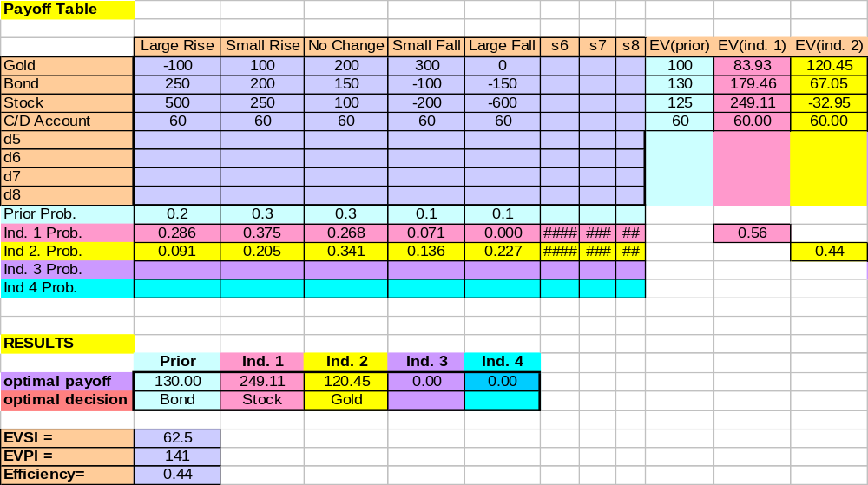
TOM BROWN – Solution
EVSI spreadsheet template

Slide 54
6.6 Decision Trees
The Payoff Table approach is useful for a non-sequential or single stage.
Many real-world decision problems consists of a sequence of dependent decisions.
Decision Trees are useful in analyzing multi-stage decision processes.

Slide 55
Characteristics of a decision tree
A Decision Tree is a chronological representation of the decision process.
The tree is composed of nodes and branches.
Chance
node
A branch emanating from a decision node corresponds to a decision alternative. It includes a cost or benefit value.
P(S₁)
Decision
node
P(S₂)
Decision 1
Cost 1
P(S₃)
P(S₁)
Decision 2
Cost 2
A branch emanating from a state of nature (chance) node corresponds to a particular state of nature, and includes the probability of this state of nature.
P(S₂)
P(S₃)

Slide 56
BILL GALLEN DEVELOPMENT COMPANY
  BGD plans to do a commercial development on a property.
  Relevant data
    Asking price for the property is 300,000 dollars.
    Construction cost is 500,000 dollars.
    Selling price is approximated at 950,000 dollars.
    Variance application costs 30,000 dollars in fees and expenses
      There is only 40% chance that the variance will be approved.
      If BGD purchases the property and the variance is denied, the property can be sold for a net return of 260,000 dollars.
      A three month option on the property costs 20,000 dollars, which will allow BGD to apply for the variance.

Slide 57
BILL GALLEN DEVELOPMENT COMPANY
  A consultant can be hired for 5000 dollars.
  The consultant will provide an opinion about the approval of the application
    P (Consultant predicts approval | approval granted) = 0.70
    P (Consultant predicts denial | approval denied) = 0.80
BGD wishes to determine the optimal strategy
  Hire/ not hire the consultant now,
  Other decisions that follow sequentially.

Slide 58
BILL GALLEN - Solution
Construction of the Decision Tree
  Initially the company faces a decision about hiring the consultant.
  After this decision is made more decisions follow regarding
    Application for the variance.
    Purchasing the option.
    Purchasing the property.

Slide 59
BILL GALLEN - The Decision Tree
0
3
Do nothing
0
Buy land
Apply for variance
-300,000
-30,000
Do not hire consultant
Purchase option
Cost = 0
-20,000
Apply for variance
-30,000
Hire consultant
Let us consider the decision
to not hire a consultant
Cost = -5000

Slide 60
BILL GALLEN - The Decision Tree
Buy land and
apply for variance
-300000 – 30000 – 500000 + 950000 =
120,000
Build
Sell
-500,000
950,000
Approved
0.4
Denied
-300000 – 30000 + 260000 =
-70,000
0.6
Sell
260,000
Buy land
Build
Sell
Approved
-300,000
-500,000
950,000
100,000
0.4
12
Denied
0.6
Purchase option and
apply for variance
-50,000

Slide 61
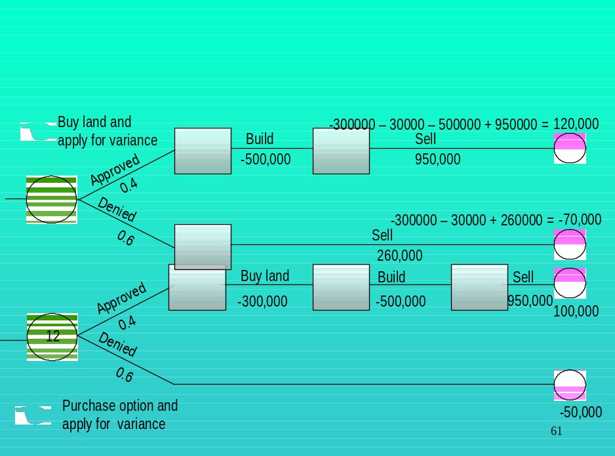
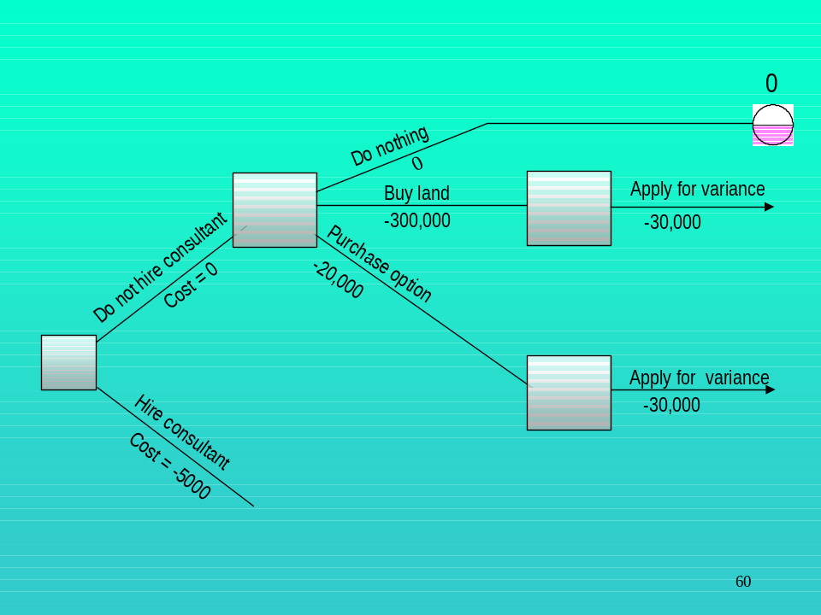
BILL GALLEN - The Decision Tree
This is where we are at this stage
Let us consider the decision to hire a consultant

Slide 62
BILL GALLEN –
The Decision Tree
Do not hire consultant
Done
-5000
0
Do Nothing
Buy land
Apply for variance
Hire consultant
Predict
Approval
-300,000
-30,000
-5000
Purchase option
0.4
-20,000
Apply for variance
-30,000
Let us consider the decision to hire a consultant
Predict
Denial
-5000
0.6
Do Nothing
Buy land
Apply for variance
-300,000
-30,000
Purchase option
-20,000
Apply for variance
-30,000

Slide 63
BILL GALLEN - The Decision Tree
115,000
Build
Sell
-500,000
950,000
Approved
?
Denied
-75,000
Sell
?
260,000
Consultant predicts an approval

Slide 64
BILL GALLEN - The Decision Tree
115,000
Build
Sell
-500,000
950,000
Approved
?
Denied
-75,000
Sell
?
260,000
The consultant serves as a source for additional information
about denial or approval of the variance.

Slide 65
BILL GALLEN - The Decision Tree
115,000
Build
Sell
-500,000
950,000
Approved
?
Denied
-75,000
Sell
?
260,000
Therefore, at this point we need to calculate the
posterior probabilities for the approval and denial
of the variance application

Slide 66
BILL GALLEN - The Decision Tree
115,000
23
Build
24
Sell
25
-500,000
950,000
Approved
.7
?
22
Denied
-75,000
26
Sell
.3
27
?
260,000
Posterior Probability of (approval | consultant predicts approval) = 0.70
Posterior Probability of (denial | consultant predicts approval) = 0.30
The rest of the Decision Tree is built in a similar manner.

Slide 67
The Decision Tree
Determining the Optimal Strategy
Work backward from the end of each branch.
At a state of nature node, calculate the expected value of the node.
At a decision node, the branch that has the highest ending node value represents the optimal decision.

Slide 68
BILL GALLEN - The Decision Tree
Determining the Optimal Strategy
115,000
115,000
115,000
(115,000)(0.7)=80500
115,000
115,000
115,000
80500
115,000
80500
23
Build
24
Sell
25
80500
-500,000
950,000
Approved
58,000
0.70
?
22
-75,000
-75,000
-75,000
-75,000
22
Denied
-75,000
-22500
-75,000
26
-75,000
0.30
Sell
27
?
-22500
260,000
-22500
(-75,000)(0.3)= -22500
With 58,000 as the chance node value,
we continue backward to evaluate
the previous nodes.

Slide 69
BILL GALLEN - The Decision Tree
Determining the Optimal Strategy
$115,000
$10,000
Build,
Sell
Do not
hire
.7
$20,200
Approved
$58,000
Buy land; Apply
for variance
Hire
$20,200
Predicts approval
.4
.3
Denied
Predicts denial
$-5,000
.6
Sell
land
Do nothing
$-75,000

Slide 70
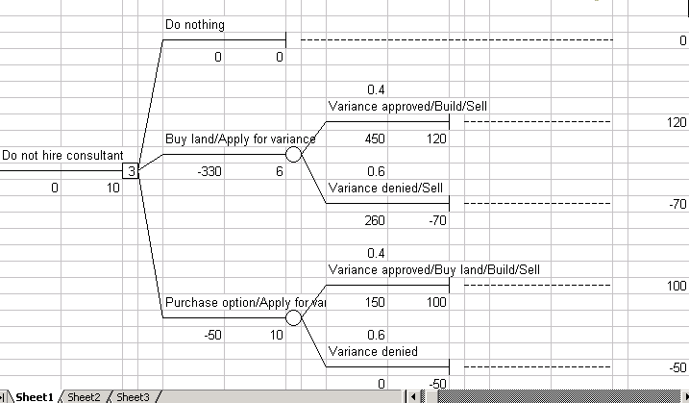
BILL GALLEN - The Decision Tree
Excel add-in: Tree Plan

Slide 71
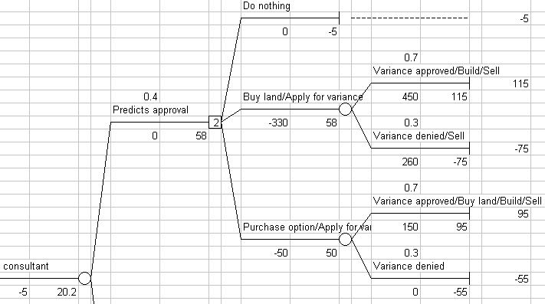
BILL GALLEN - The Decision Tree
Excel add-in: Tree Plan

Slide 72
6.7 Decision Making and Utility
Introduction
  The expected value criterion may not be appropriate if the decision is a one-time opportunity with substantial risks.
  Decision makers do not always choose decisions based on the expected value criterion.
    A lottery ticket has a negative net expected return.
    Insurance policies cost more than the present value of the expected loss the insurance company pays to cover insured losses.

Slide 73
The Utility Approach
It is assumed that a decision maker can rank decisions in a coherent manner.
Utility values, U(V), reflect the decision maker’s perspective and attitude toward risk.
Each payoff is assigned a utility value. Higher payoffs get larger utility value.
The optimal decision is the one that maximizes the expected utility.

Slide 74
Determining Utility Values
The technique provides an insightful look into the amount of risk the decision maker is willing to take.
The concept is based on the decision maker’s preference to taking a sure payoff versus participating in a lottery.

Slide 75
Determining Utility Values
Indifference approach for assigning utility values
List every possible payoff in the payoff table in ascending order.
Assign a utility of 0 to the lowest value and a value of 1 to the highest value.
For all other possible payoffs (R_{ij}) ask the decision maker the following question:

Slide 76
Determining Utility Values
Indifference approach for assigning utility values
Suppose you are given the option to select one of the following two alternatives:
  Receive $R_{ij} (one of the payoff values) for sure,
  Play a game of chance where you receive either
    The highest payoff of $R_{max} with probability p, or
    The lowest payoff of $R_{min} with probability 1- p.

Slide 77

Determining Utility Values
Indifference approach for assigning utility values
p
R_{max}
1-p
R_{ij}
R_{min}
What value of p would make you indifferent between the two situations?”

Slide 78
Determining Utility Values
Indifference approach for assigning utility values
p
R_{max}
1-p
R_{ij}
R_{min}
The answer to this question is the indifference probability for the payoff R_{ij} and is used as the utility values of R_{ij}.

Slide 79
Determining Utility Values
Indifference approach for assigning utility values
Example:
s₁
s₁
d₁
150
100
d₂
-50
140
Alternative 1
A sure event
For p = 1.0, you’ll
prefer Alternative 2.
For p = 0.0, you’ll
prefer Alternative 1.
Thus, for some p
between 0.0 and 1.0
you’ll be indifferent
between the alternatives.
Alternative 2
(Game-of-chance)
$150
$100
1-p
p
-50

Slide 80
Determining Utility Values
Indifference approach for assigning utility values
s₁
s₁
d₁
150
100
d₂
-50
140
Alternative 1
A sure event
Let’s assume the
probability of
indifference is p = .7.
U(100)=.7U(150)+.3U(-50)
= .7(1) + .3(0) = .7
Alternative 2
(Game-of-chance)
$150
$100
1-p
p
-50

Slide 81
TOM BROWN - Determining Utility Values
Data
  The highest payoff was $500. Lowest payoff was -$600.
  The indifference probabilities provided by Tom are
  Tom wishes to determine his optimal investment Decision.
Payoff
-600
-200
-150
-100
0
60
100
150
200
250
300
500
Prob.
0
0.25
0.3
0.36
0.5
0.6
0.65
0.7
0.75
0.85
0.9
1

Slide 82
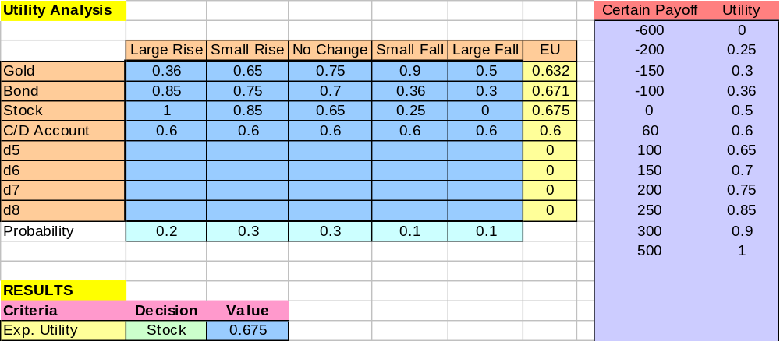
TOM BROWN – Optimal decision (utility)

Slide 83
Three types of Decision Makers
Risk Averse -Prefers a certain outcome to a chance outcome having the same expected value.
Risk Taking - Prefers a chance outcome to a certain outcome having the same expected value.
Risk Neutral - Is indifferent between a chance outcome and a certain outcome having the same expected value.

Slide 84
The Utility Curve for a
Risk Averse Decision Maker
Utility
U(200)
U(150)
EU(Game)
The utility of having $150 on hand…
U(100)
…is larger than the expected utility
of a game whose expected value
is also $150.
100
0.5
150
200
0.5
Payoff

Slide 85
The Utility Curve for a
Risk Averse Decision Maker
Utility
U(200)
U(150)
EU(Game)
A risk averse decision maker avoids
the thrill of a game-of-chance,
whose expected value is EV, if he
can have EV on hand for sure.
U(100)
Furthermore, a risk averse decision maker is willing to pay a premium…
…to buy himself (herself) out of the
game-of-chance.
100
0.5
CE
150
200
0.5
Payoff

Slide 86
Utility
Risk Averse Decision Maker
Risk Neutral Decision Maker
Risk Taking Decision Maker
Payoff

Slide 87
6.8 Game Theory
Game theory can be used to determine optimal decisions in face of other decision making players.
All the players are seeking to maximize their return.
The payoff is based on the actions taken by all the decision making players.

Slide 88
Classification of Games
  By number of players
    Two players - Chess
    Multiplayer – Poker
  By total return
    Zero Sum - the amount won and amount lost by all competitors are equal (Poker among friends)
    Nonzero Sum -the amount won and the amount lost by all competitors are not equal (Poker In A Casino)
  By sequence of moves
    Sequential - each player gets a play in a given sequence.
    Simultaneous - all players play simultaneously.

Slide 89
IGA SUPERMARKET
The town of Gold Beach is served by two supermarkets: IGA and Sentry.
Market share can be influenced by their advertising policies.
The manager of each supermarket must decide weekly which area of operations to discount and emphasize in the store’s newspaper flyer.

Slide 90
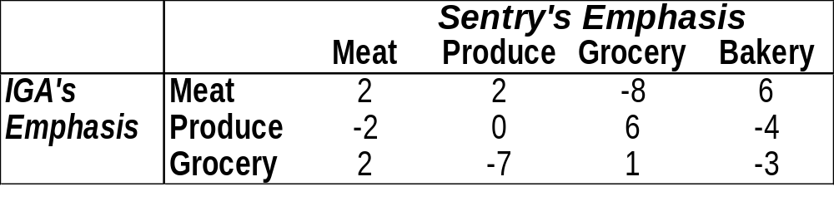
IGA SUPERMARKET
Data
  The weekly percentage gain in market share for IGA, as a function of advertising emphasis.
  A gain in market share to IGA results in equivalent loss for Sentry, and vice versa (i.e. a zero sum game)

Slide 91
IGA needs to determine an advertising
emphasis that will maximize its expected
change in market share regardless of
Sentry’s action.

Slide 92
IGA SUPERMARKET - Solution
To prevent a sure loss of market share, both IGA and Sentry should select the weekly emphasis randomly.
Thus, the question for both stores is:
What proportion of the time each area should be emphasized by each store?

Slide 93
IGA’s Linear Programming Model
Decision variables
  X₁ = the probability IGA’s advertising focus is on meat.
  X₂ = the probability IGA’s advertising focus is on produce.
  X ₃ = the probability IGA’s advertising focus is on groceries.
Objective Function For IGA
  Maximize expected market increase regardless of Sentry’s advertising policy.

Slide 94
IGA’s Perspective
Constraints
  IGA’s market share increase for any given advertising focus selected by Sentry, must be at least V.
The model
    Max V
    S.T.
    Meat 2X₁ – 2X₂ + 2X₃ ≥ V
    Produce 2X₁ – 7 X₃ ≥ V
    Groceries -8X₁ – 6X₂ + X₃ ≥ V
    Bakery 6X₁ – 4X₂ – 3X₃ ≥ V
    Probability X₁ + X₂ + X₃ = 1
IGA’s expected change
in market share.
Sentry’s
advertising
emphasis

Slide 95
Sentry’s Linear Programming Model
Decision variables
  Y₁ = the probability Sentry’s advertising focus is on meat.
  Y₂ = the probability Sentry’s advertising focus is on produce.
  Y ₃ = the probability Sentry’s advertising focus is on groceries.
  Y₄ = the probability Sentry’s advertising focus is on bakery.
Objective Function For Sentry
  Minimize the changes in market share in favor of IGA

Slide 96
Sentry’s perspective
Constraints
  Sentry’s market share decrease for any given advertising focus selected by IGA, must not exceed V.
The Model
    Min V
    S.T.
    2Y₁ + 2Y₂ – 8Y₃ + 6Y₄ ≤ V
    -2Y₁ + 6Y₃ – 4Y₄ ≤ V
    2Y₁ – 7Y₂ + Y₃ – 3Y₄ ≤ V
    Y₁ + Y₂ + Y₃ + Y₄ = 1
    Y₁, Y₂, Y₃, Y₄ are non-negative; V is unrestricted

Slide 97
IGA SUPERMARKET – Optimal Solution
For IGA
  X₁ = 0.3889; X₂ = 0.5; X₃ = 0.1111
For Sentry
  Y₁ = .3333; Y₂ = 0; Y₃ = .3333; Y4 = .3333
For both players V =0 (a fair game).

Slide 98
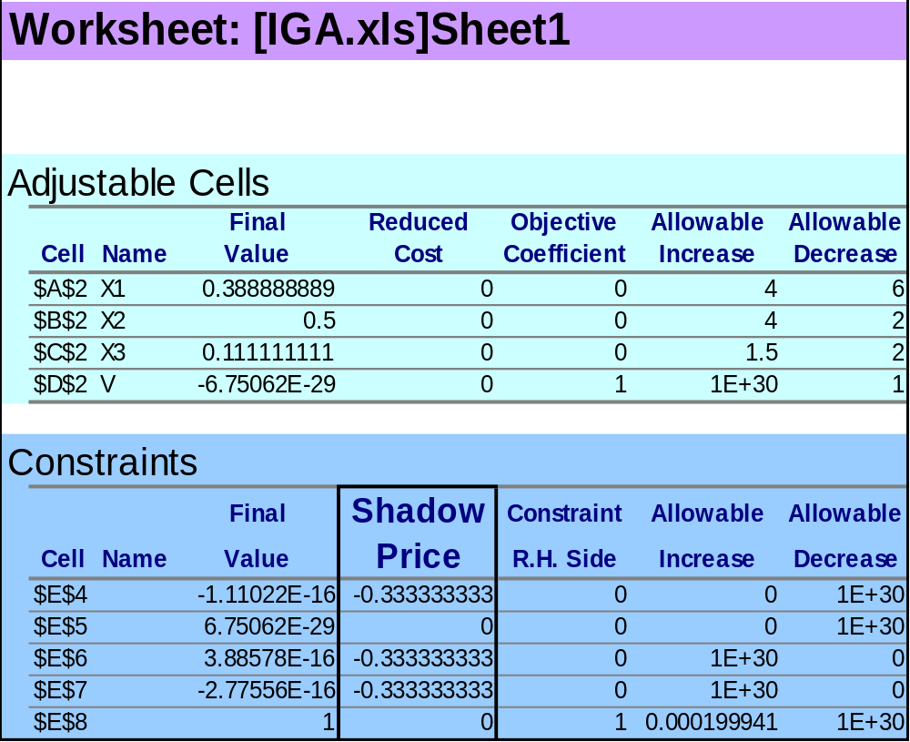
IGA Optimal Solution - worksheet

Slide 99
Copyright © 2002 John Wiley & Sons, Inc. All rights reserved. Reproduction or translation of this work beyond that named in Section 117 of the United States Copyright Act without the express written consent of the copyright owner is unlawful. Requests for further information should be addressed to the Permissions Department, John Wiley & Sons, Inc. Adopters of the textbook are granted permission to make back-up copies for their own use only, to make copies for distribution to students of the course the textbook is used in, and to modify this material to best suit their instructional needs. Under no circumstances can copies be made for resale. The Publisher assumes no responsibility for errors, omissions, or damages, caused by the use of these programs or from the use of the information contained herein.

